Slide 1
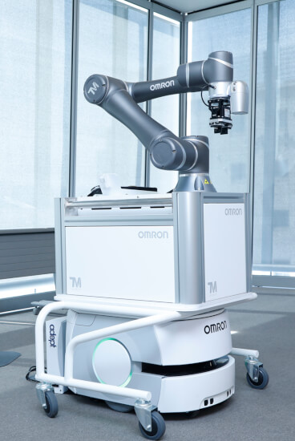
Mobile Manipulator in a Hospital Environment
Group 31:
Amin Berjaoui Tahmaz - 5610737
Edoardo Panichi - 5630444
Gioele Buriani - 5629888
Giovanni Corvi - 5608899

Slide 2
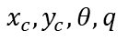
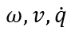
Model and Planning
Start, Goal,
Obstacles
Reference Trajectory
RRT & RRT*
Path
Trajectory Smoother
Controllers
$$x_{c},y_{c}, θ, q$$
$$ω, v, \dot{q}$$
Model: Differential drive base with a 2 DoF manipulator
Controllers: PIDs
Path Planner: RRT and Informed-RRT*
Collision Detection
Smoothed Trajectory
Physical Models

Slide 3
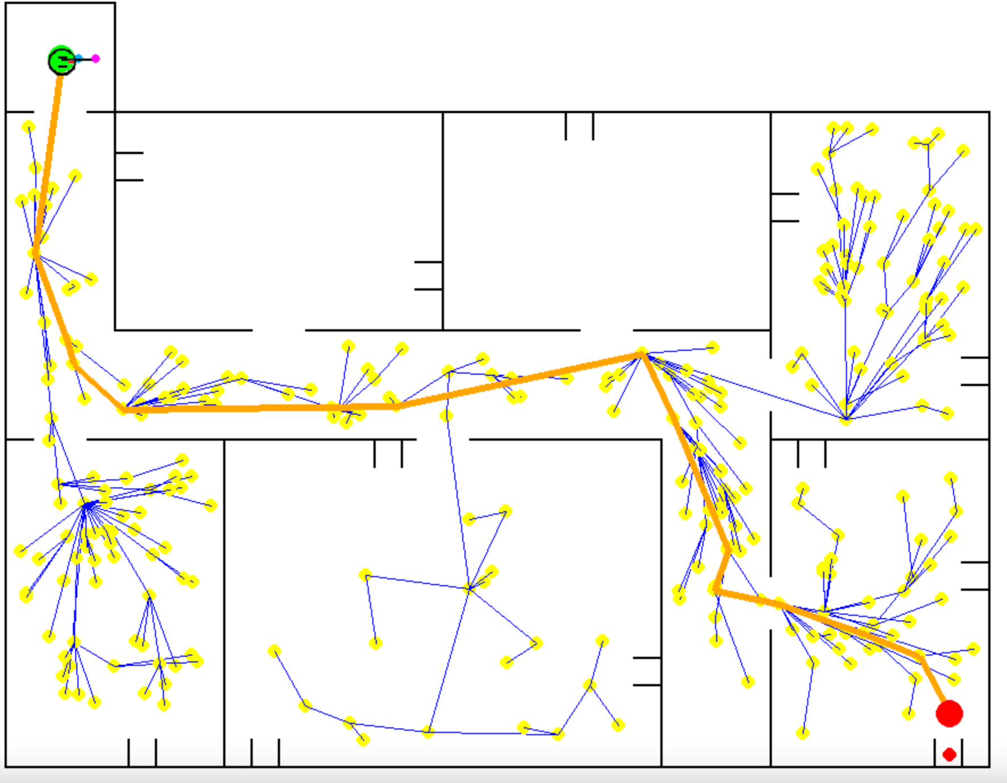
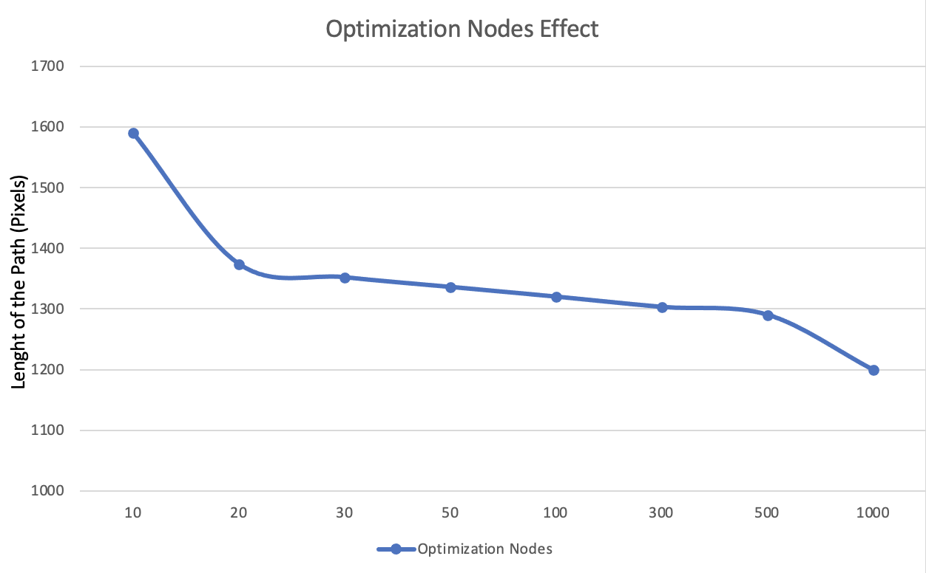
Results
A good trade-off between optimality and computational cost is required.

Slide 4
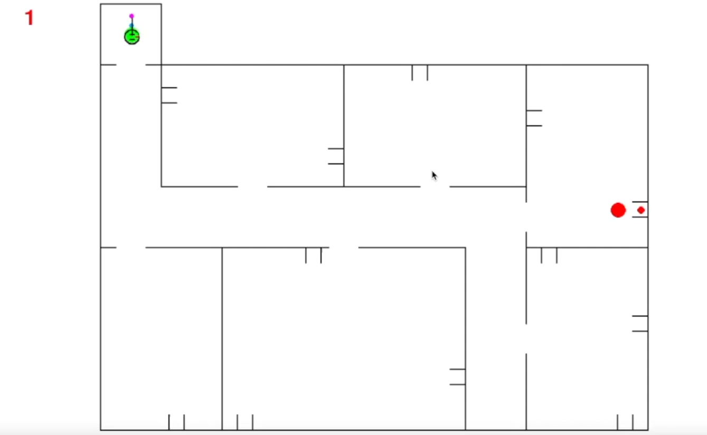
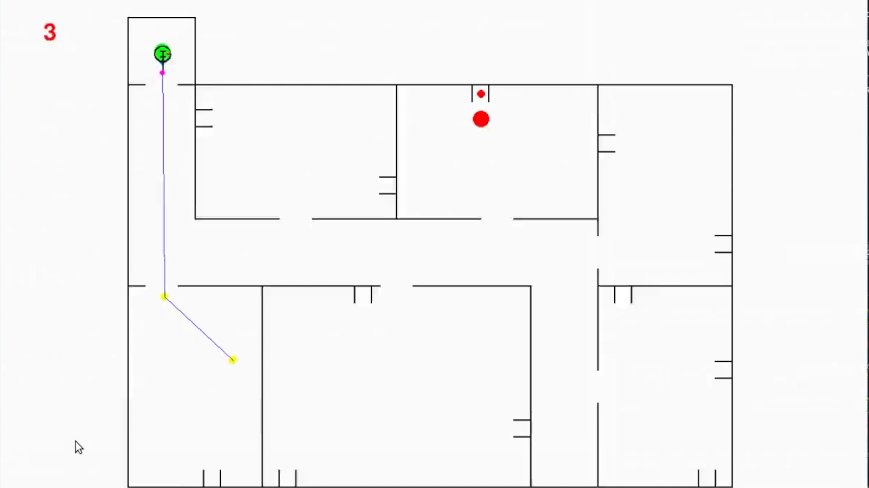
Results - Video (speed-up)

Slide 5
Discussion & Future Work
PIDs are simple controllers.
Complete knowledge of the environment is required.
Computationally expensive.

